Slide 1


Python for Data Analysis: Unleashing the Power of Data By THARUN VADLAMUDI HARSHA JAMPANI POOJA CH Bhanu Teja Mounika

Slide 2

Content
1. Introduction to Python for Data Analysis
2. Practical Applications of Python in Data Analysis
3. Python Data Analysis Tools and Techniques

Slide 3

Introduction to Python for Data Analysis
Section 1

Slide 4




Importance of Data Analysis
Career Opportunities
Learning Python for data analysis opens doors to a wide range of career opportunities in data science, machine learning, and analytics.
Data-Driven Decision Making
Python empowers individuals and organizations to make informed decisions by extracting valuable insights from data, leading to improved strategies and outcomes.
Business Intelligence
Python's data analysis capabilities enable businesses to gain a competitive edge by uncovering trends, patterns, and correlations within their data.
01
02
03

Slide 5
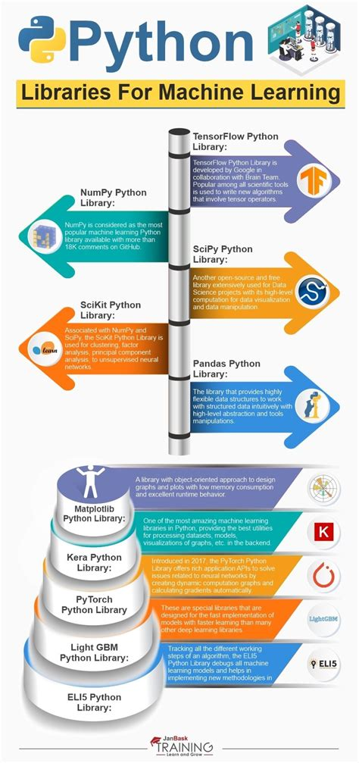

Python for Data Analysis Basics
Data Structures
Python's versatile data structures, such as lists, dictionaries, and arrays, provide a solid foundation for organizing and manipulating data effectively.
Data Cleaning and Preprocessing
Python offers powerful libraries like pandas and NumPy for cleaning, transforming, and preparing data for analysis, ensuring data quality and accuracy.
Statistical Analysis
Python's rich ecosystem of statistical libraries, including SciPy and StatsModels, enables in-depth statistical analysis and hypothesis testing.

Slide 6



Python Data Visualization
Storytelling with Data
Python empowers storytellers to convey compelling narratives through data visualization, making complex information accessible and engaging.
Interactive Visualizations
With libraries like Plotly and Bokeh, Python facilitates the development of interactive visualizations, enabling users to explore data dynamically.
Matplotlib and Seaborn
Python's visualization libraries allow for the creation of insightful charts, graphs, and visual representations of data, enhancing the communication of findings.

Slide 7
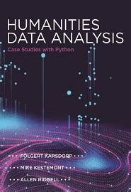
Case Studies in Python Data Analysis
Financial Data Analysis
Explore how Python is used in financial institutions to analyze market trends, risk assessment, and investment strategies, showcasing the practical applications of data analysis.
Healthcare Analytics
Delve into real-world examples of Python being utilized for analyzing patient data, medical research, and healthcare resource optimization, demonstrating the impact of data analysis in healthcare.
E-commerce Insights
Understand how Python aids e-commerce companies in analyzing customer behavior, market trends, and sales performance to drive business growth and enhance customer experience.

Slide 8

Practical Applications of Python in Data Analysis
Section 2

Slide 9

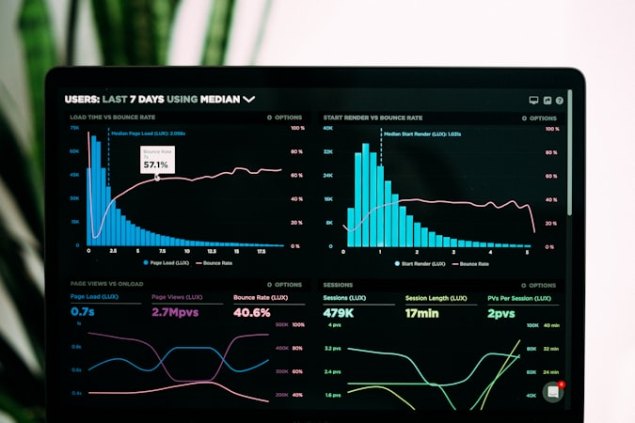

Data Wrangling with Python
Data Transformation
Learn how Python enables the transformation of raw data into a structured, usable format through techniques like normalization, encoding, and feature engineering.
Data Cleaning Techniques
Explore practical methods and libraries in Python for handling missing data, outliers, and inconsistencies, ensuring data integrity and reliability.
Data Acquisition
Python facilitates the collection and extraction of data from various sources, including databases, APIs, and web scraping, streamlining the data acquisition process.

Slide 10
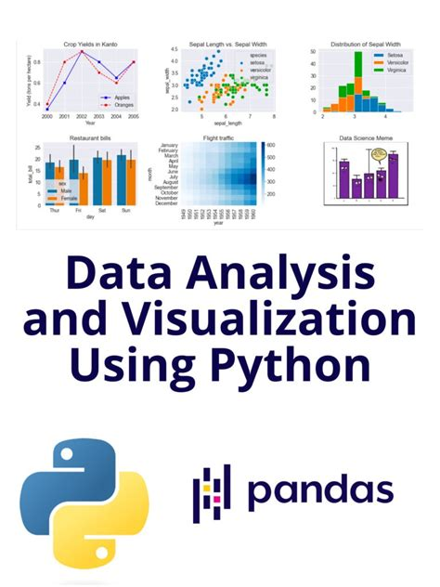
Exploratory Data Analysis (EDA
Descriptive Statistics
Python empowers analysts to generate descriptive statistics, distributions, and summaries to gain initial insights into the data, guiding further analysis.
Data Visualization for EDA
Understand how Python's visualization tools are used in exploratory data analysis to identify patterns, correlations, and anomalies within the data.
Hypothesis Testing
Learn about Python's capabilities for conducting hypothesis tests and statistical inference to validate assumptions and make data-driven decisions.

Slide 11
Machine Learning with Python
Model Evaluation and Validation
Learn about Python's tools for evaluating and validating machine learning models, ensuring their accuracy and generalization to new data.
Supervised Learning
Explore how Python's machine learning libraries, such as scikit-learn, enable the development of predictive models for classification and regression tasks.
Unsupervised Learning
Understand the applications of Python in unsupervised learning, including clustering, dimensionality reduction, and anomaly detection for pattern recognition.
01
02
03

Slide 12



Real-time Data Analysis
Predictive Analytics
Understand how Python supports real-time predictive analytics, allowing for the forecasting of trends and patterns in dynamic data environments.
Interactive Dashboards
Explore the development of interactive dashboards and real-time visualizations using Python, enabling users to monitor and analyze live data effectively.
Streaming Data Processing
Discover how Python is utilized for real-time data analysis, including processing data streams, detecting events, and generating timely insights.

Slide 13
Python Data Analysis Tools and Techniques
Section 3

Slide 14


Pandas and NumPy for Data Manipulation
Data Structures in Pandas
Explore the powerful data structures in pandas, including Series and DataFrame, for efficient data manipulation and analysis.
Array Operations with NumPy
Understand how NumPy's array operations and functions enable fast and vectorized computations, enhancing performance in data analysis.
01
02

Slide 15


Time Series Analysis with Python
Seasonal Decomposition
Explore Python's capabilities for decomposing time series data into trend, seasonality, and residual components, aiding in understanding underlying patterns.
Time Series Data Handling
Learn how Python facilitates the handling and analysis of time series data, including techniques for resampling, shifting, and rolling window operations.

Slide 16

Text Analysis and Natural Language Processing (NLP
Text Preprocessing
Understand how Python is used for text preprocessing tasks, including tokenization, stemming, and lemmatization, to prepare text data for analysis.
Sentiment Analysis
Explore Python's libraries for sentiment analysis and text classification, enabling the extraction of insights from textual data.

Slide 17
Advanced Data Analysis Techniques
Dimensionality Reduction
Delve into Python's techniques for dimensionality reduction, including principal component analysis (PCA) and t-distributed stochastic neighbor embedding (t-SNE).
Ensemble Methods
Understand how Python supports ensemble learning methods, such as random forests and gradient boosting, for improved predictive performance.
01
02

Slide 18


